Slide 1
How Apache Spark works

Slide 2
What is Spark?
Not a modified version of Hadoop
Separate, fast, MapReduce-like engine
In-memory data storage for very fast iterative queries
General execution graphs and powerful optimizations
Up to 40x faster than Hadoop
Spark was published in the following conference.
Matei Zeharia, Mosharaf Chowdhury, Tathagata Das, et al., Resilient Distributed Datasets: A Fault-Tolerant Abstraction for In-Memory Cluster Computing, NSDI 2012.
NSDI is the top conference for networking systems. This paper won the best paper award for 2012.

Slide 3
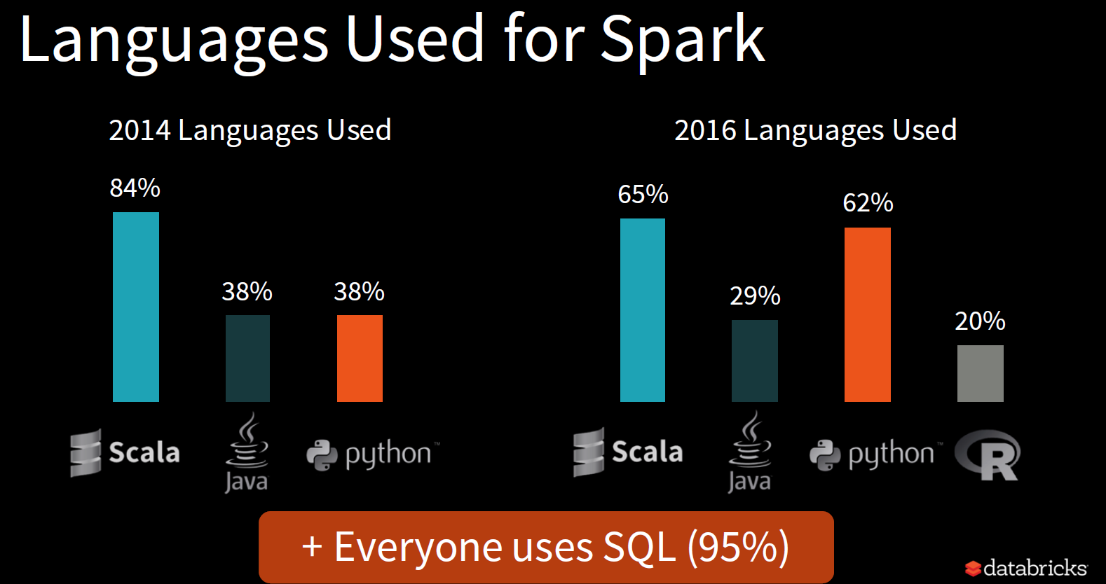

Slide 4
Hadoop Compatibility
Spark can read/write to any storage system / format that has a plugin for Hadoop!
Examples: HDFS, S3, HBase, Cassandra, Avro, SequenceFile
Reuses Hadoop’s InputFormat and OutputFormat APIs
APIs like SparkContext.textFile support filesystems, while SparkContext.hadoopRDD allows passing any Hadoop JobConf to configure an input source

Slide 5
Spark Software Stack
Shark (Hive on Spark)
GraphX
Streaming Spark
…
Spark
Local mode
EC2
Apache Mesos
YARN

Slide 6
Awesome Usability
Supports the following APIs
Scala
Java
Python
Interactive shell
Scala is a really nice way to write programs!
I totally recommend that you program Spark using Scala
Before talking about the awesome Scala API we will first talk about what makes Spark so fast.

Slide 7
Data Sharing in MapReduce
HDFS read
HDFS write
HDFS read
HDFS write
iter. 1
iter. 2
. . .
Input
HDFS read
query 1
result 1
query 2
result 2
query 3
result 3
Input
. . .
Scenario 1(iterative algorithms): MapReduce needs to read and write to HDFS in between every iteration
Scenario 2(multiple queries): even for a set of queries working on the same data, the data need to be loaded from HDFS at the beginning of every job.

Slide 8

Data Sharing in Spark
iter. 1
iter. 2
. . .
Input
query 1
one-time processing
query 2
query 3
Input
Distributed memory
. . .
Scenario 1(iterative algorithms): Spark caches all the data in memory so no need to read and write to HDFS in between every iteration
Scenario 2(multiple queries): Spark can cache data that is used by different queries in RAM thereby avoid reading from HDFS for every query.

Slide 9
Spark Programming Model
Key idea: resilient distributed datasets (RDDs)
Distributed collections of objects that can be cached in memory across cluster nodes
Manipulated through various parallel operators
Automatically rebuilt on failure

Slide 10

Example: Log Mining
Load error messages from a log into memory, then interactively search for various patterns
In the example below lines, errors, messages, cachedMsgs are all RDDs
Don’t worry if you do not understand all the details we will cover scala in much more detail later.
Base RDD
Cache 1
lines = spark.textFile(“hdfs://...”)
errors = lines.filter(_.startsWith(“ERROR”))
messages = errors.map(_.split(‘\t’)(2))
cachedMsgs = messages.cache()
Worker
Transformed RDD
results
tasks
Block 1
Driver
Action
cachedMsgs.filter(_.contains(“foo”)).count
cachedMsgs.filter(_.contains(“bar”)).count
Cache 2
Worker
. . .
Result: scaled to 1 TB data in 5-7 sec (vs 170 sec for on-disk data)
Cache 3
Result: full-text search of Wikipedia in <1 sec (vs 20 sec for on-disk data)
Worker
Block 2
Block 3

Slide 11
Properties of RDDs
lines = spark.textFile(“hdfs://...”)
errors = lines.filter(_.startsWith(“ERROR”))
messages = errors.map(_.split(‘\t’)(2))
cachedMsgs = messages.cache()
cachedMsgs.filter(_.contains(“foo”)).count
cachedMsgs.filter(_.contains(“bar”)).count
Each line of code transforms the data from one RDD to another.
All RDDs are read only.
This property is very important. It means multiple tasks can share the data without worrying about race conditions.
No chance of inconsistent state from multiple concurrent writes.
All of the above RDDs are temporary collections meaning they will be automatically destroyed when no longer in use except for cachedMsgs
The cachedMsgs RDD is cached in RAM and therefore subsequent methods on the RDD will be run in RAM.

Slide 12
Partitions
RDD
RDDs are stored distributed across the cluster
Each node of the cluster stores a separate partition of the RDD.
Spark like MapReduce always tries to move the computation to the data.
When operating on the data stored in HDFS it consults HDFS to find where the data is stored before launching its work tasks on it.

Slide 13
Partitions
RDD
Users can ask that an RDD’s elements be partitioned across machines based on a key in each record.
This is useful for placement optimizations
E.g. if two datasets are hash-partitioned the same way then it is much cheaper to join them using the knowledge of the partition information.

Slide 14
Action
lines = spark.textFile(“hdfs://...”)
errors = lines.filter(_.startsWith(“ERROR”))
messages = errors.map(_.split(‘\t’)(2))
cachedMsgs = messages.cache()
cachedMsgs.filter(_.contains(“foo”)).count
cachedMsgs.filter(_.contains(“bar”)).count
Like pig the spark interpreter does not actually execute any commands until an action is encountered.
This is called lazy evaluation
It gives the system a chance to inspect all the code before working out the best execution plan
Actions are operations that return a value to the application or export data to a storage system
Example actions
Count: returns the number of elements in the dataset
Collect: returns the elements themselves
Save: outputs the dataset to a storage system

Slide 15
Storage options for persistent RDDs
RDD can be made persistent in the following three ways
Deserialized and in memory
This is the fastest method since it means the objects can be reused without the overhead of serialization/deserialization
The computational cost of serialization/deserialization can be very high in Java.
This is the same as using the .cache() method call
Example
pMsg = messages.persist(spark.storage.StorageLevel.MEMORY_ONLY)
Same as:
pMsg = messages.cache();
Serialized and in memory
This can significantly reduce the memory footprint of the cached objects.
For example a linked list of integers contains the following per item
4 byte data, 8 byte pointer, etc.
We only need to store the 4 byte data per item if the data is serialized
Example
pMsg = Messages.persist(spark.storage.StorageLevel.MEMORY_ONLY_SER)

Slide 16
Storage options for persistent RDDs
Persistent RDDs can be stored on disk
Good when too large to fit in memory but too costly to recompute.
Example
pMsg = messages.persist(spark.storage.StorageLevel.DISK_ONLY)
Sometimes RDDs do not all fit in memory
Use Least Recently Used policy to evict entire RDDs

Slide 17
Fault Tolerance
RDDs track the series of transformations used to build them (their lineage) to recompute lost data
E.g:
messages = textFile(...).filter(_.contains(“error”))
.map(_.split(‘\t’)(2))
HadoopRDD
path = hdfs://…
FilteredRDD
func = _.contains(...)
MappedRDD
func = _.split(…)

Slide 18
Fault Tolerance
messages = textFile(...).filter(_.contains(“error”))
.map(_.split(‘\t’)(2))
HadoopRDD
path = hdfs://…
FilteredRDD
func = _.contains(...)
MappedRDD
func = _.split(…)
RDDs provide an interface for coarse-grained transformations which makes fault tolerance much cheaper via lineage
Contrast this to traditional methods of
Storing a log record of every update to every single record.
High storage and latency cost.
Replication of data
Waste of disk and memory
If a partition of a RDD is lost, the RDD has enough information about how it was derived to recompute just that partition

Slide 19
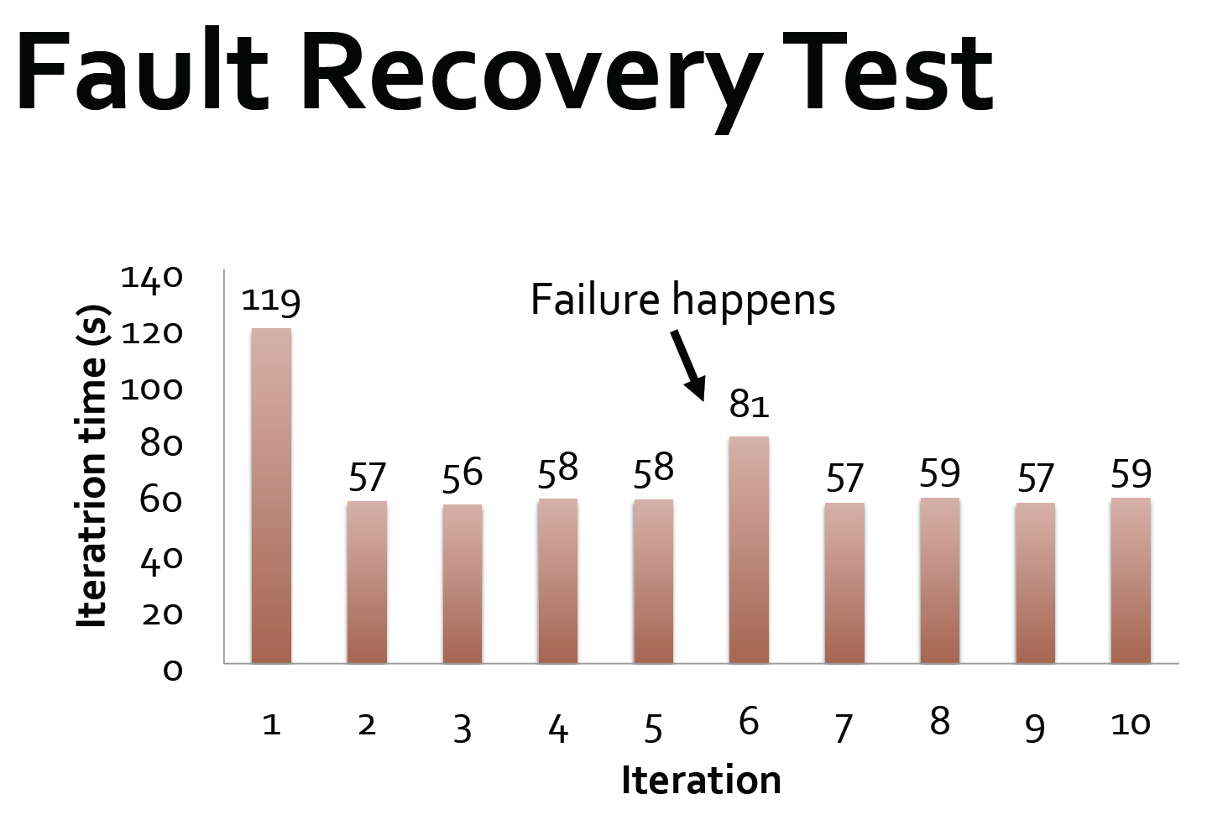

Slide 20
